Slide 1

Securing Enterprise Applications
(Java EE 6)
Action based Authorization
(a different flavor)
by Roy Donasco

Slide 2

Oracle Samples
Declarative Authorization
Programatic Authorization
Reference: http://docs.oracle.com/javaee/6/tutorial/doc/bnbyl.html

Slide 3
Declarative
@DeclareRoles({"Administrator", "Manager", "Employee"})public class Calculator
{ @RolesAllowed("Administrator") public void setNewRate(int rate)
  { ... }
@PermitAll public long convertCurrency(long amount) { //... }}

Slide 4
Programatic
@Stateless
public class PayrollBean implements Payroll
{ @Resource SessionContext ctx; public void updateEmployeeInfo(EmplInfo info)
  { oldInfo = ... read from database; // The salary field can be changed only by callers // who have the security role "payroll" if (info.salary != oldInfo.salary && !ctx.isCallerInRole("payroll")) { throw new SecurityException(...); } ... } ... }

Slide 5
Limitations
Hardcoded Roles
Rigid
Not Flexible
Does not support organizational change

Slide 6
Action Based Authorization
Represents Pragmatic Usage (User Story)
Supports Organizational expansion
No hard coded Roles
Only actions on resource

Slide 7
Readable Capability
Edit User
Delete User
Change Color
Add Account

Slide 8
Declarative
public class Calculator
{
@Secured @SecuredCapability(action=”change”,resource=”rate”) public void setNewRate(int rate)
{ ... }
// do not annotate methods that are not secured. public long convertCurrency(long amount) { //... }}

Slide 9
Programatic
public class EmployeeEditorController
implements ViewController<EmployeeEditor>
{
  @Injectprivate SessionSecurityChecker sessionSecurityChecker;
public void updateEmployeeInfo(EmplInfo info)
  { oldInfo = ... read from database; // The salary field can be changed only by callers // who are allowed to do it,
// or has been assigned with roles that are allowed to do it
  // or is a member of
  // groups assigned with roles that are allowed to do it.
  sessionSecurityChecker.checkAccess(“salary”,”compute”);
  ... } ... }

Slide 10
Organized
Capability
  Resource
  Actions
Role
  Capabilities
Group
  Roles

Slide 11
Capability Sample
Compute Salary
  Resource : salary
  Actions : view, compute
Approve Salary
  Resource : salary
  Actions : approve
Manage Employee
  Resource : employee
  Actions : add, edit, fire, view
Configure Employee Roles
  Resource : employeeRole
  Actions : assign, revoke

Slide 12
Role Sample
Role : Finance Officer
  Capabilities : Compute Salary
Role : Finance Manager
  Capabilities : Approve Salary, Compute Salary
Role : HR Manager
  Capabilities : Manage Employee, Configure Employee Roles

Slide 13
Group Sample
Finance Managers
  Finance Manager
  Accounting Manager
HR Managers
  HR Manager

Slide 14
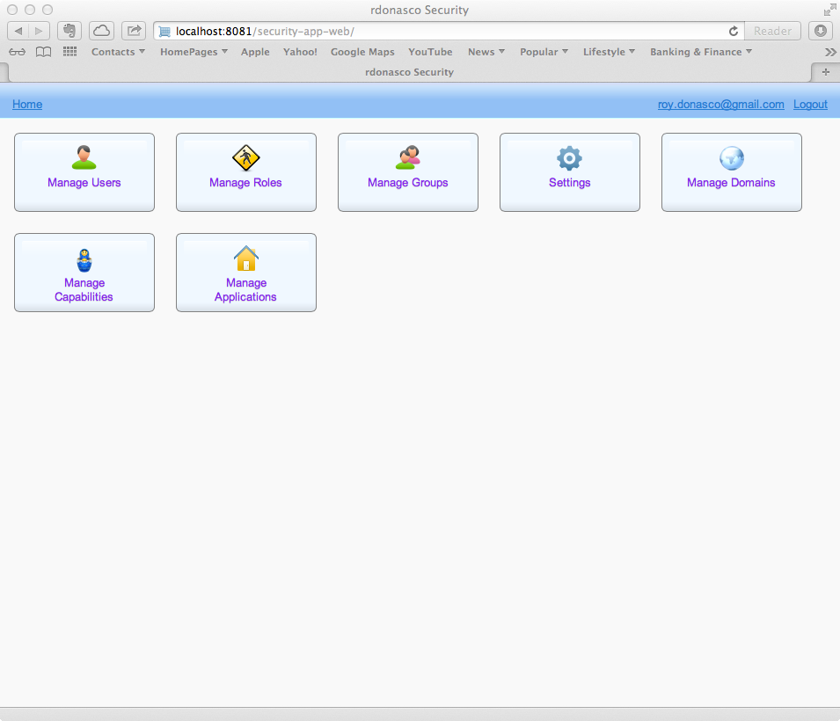
Security Enterprise Application

Slide 15
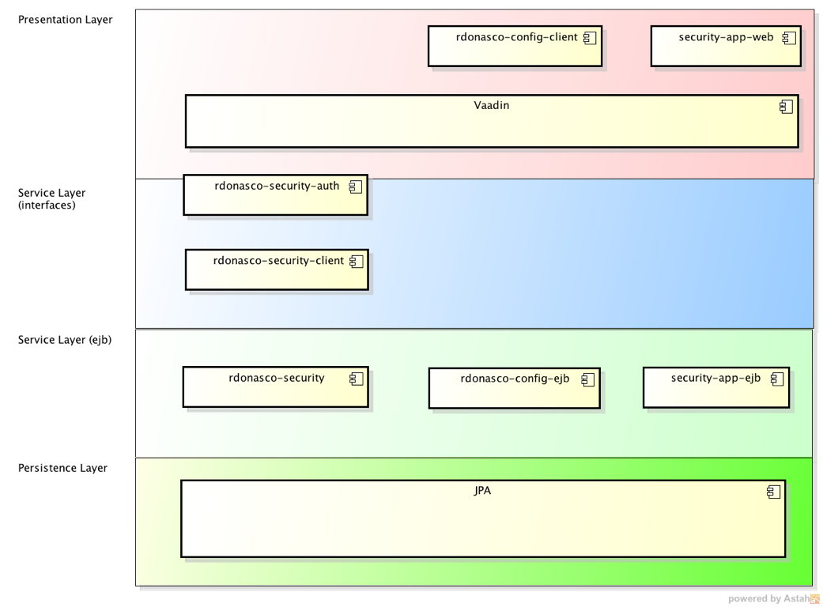
Security Enterprise App

Slide 16
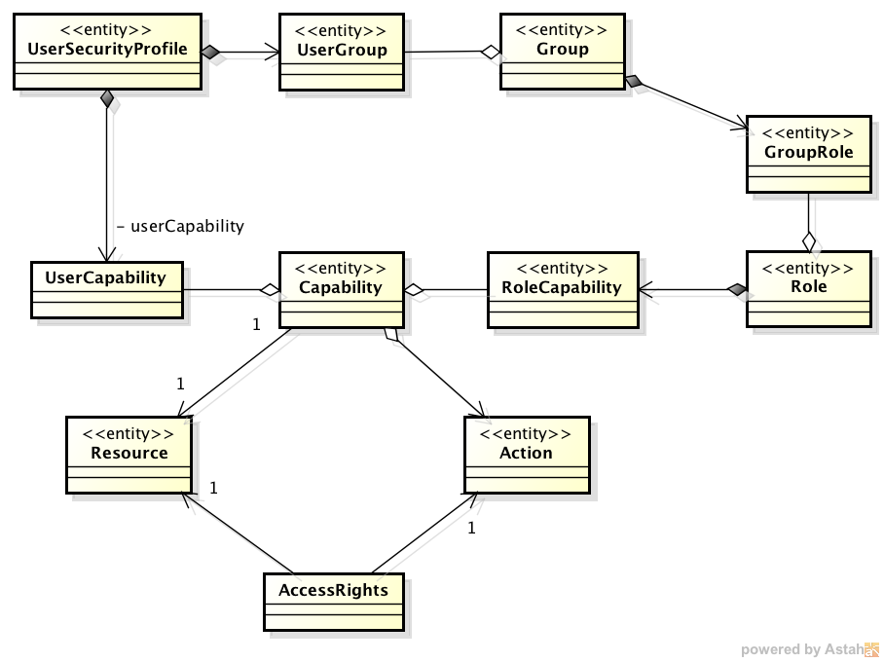
Data Model

Slide 17
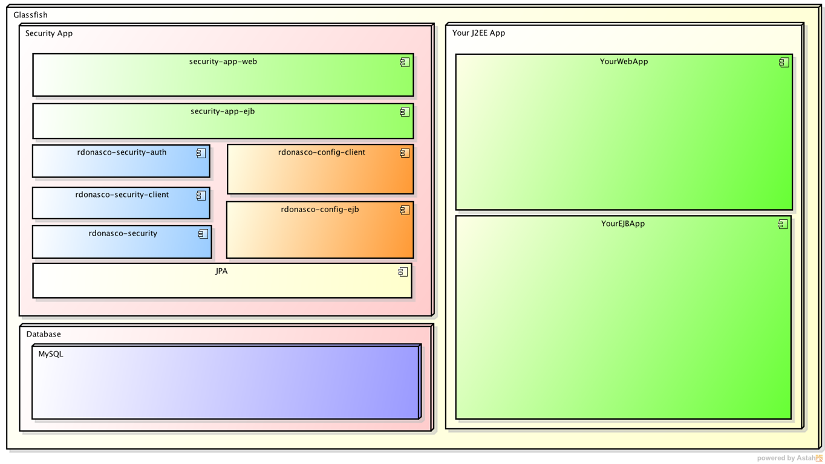
Deployment Architecture

Slide 18
integration
Authentication
Authorization
User profile creation

Slide 19

Integration: Authentication

Slide 20

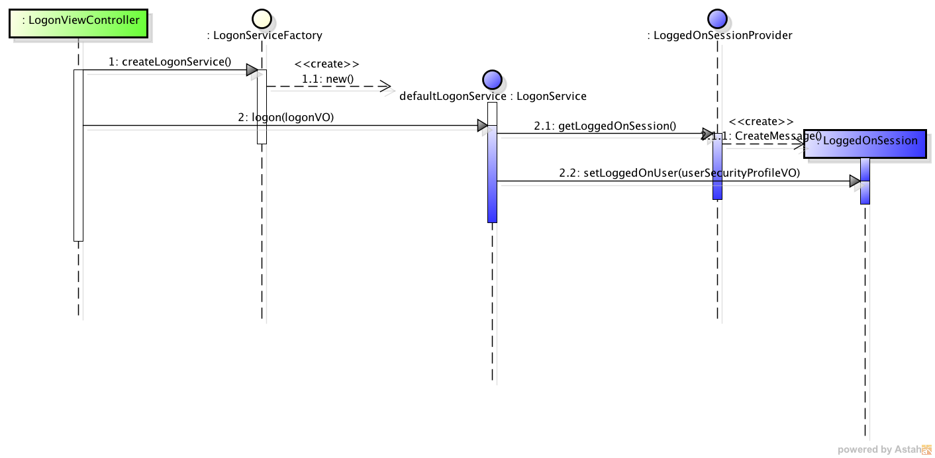
Integration: Authentication

Slide 21
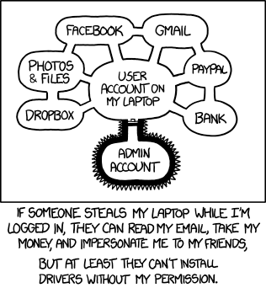
Integration : Authorization

Slide 22
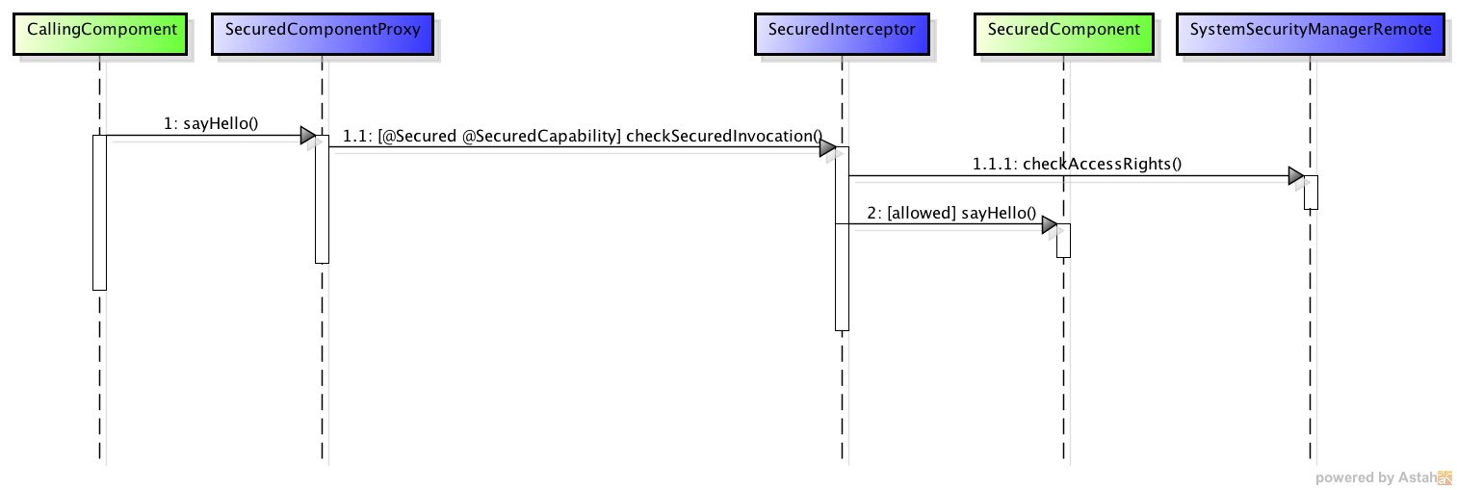
Integration : Authorization Declarative using Interceptor

